Slide 1

Team Collaboration
The CRM System Implementation aims to revolutionize customer relations with a robust system for streamlined interactions and data management.
by aya chkioua

Slide 2
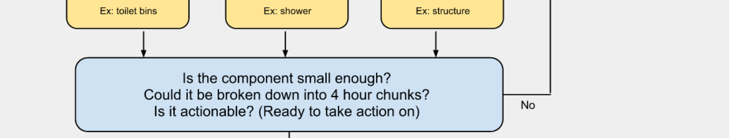
Project Overview
The CRM System Implementation project aims to revolutionize customer relations by introducing a robust system to streamline interactions and data management.

Slide 3
Project Team Structure
1
Project Manager
Sergey
2
Developers
Sergey, Aya
3
Analysts
Eva
4
Testers
Sarina

Slide 4
Team Roles and Responsibilities
Project Manager (Sergey)
Developers (Sergey, Aya)
Analysts (Eva)
Testers (Sarina)
Responsible for data analysis and requirements gathering.
Ensures system functionality and identifies bugs.
Coordinates project activities and oversees team progress.
Responsible for customization and integration of the CRM system.

Slide 5
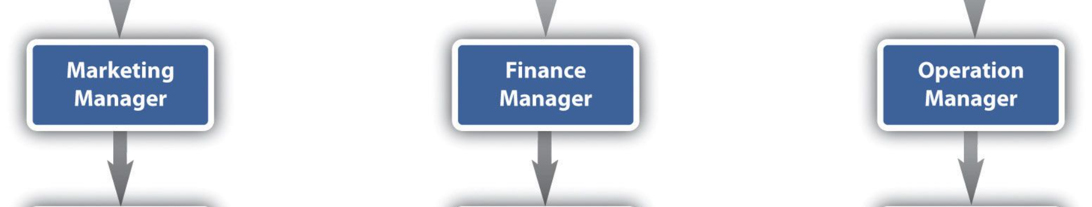
Communication Strategies
1
Team Meetings
2
Slack
3
Project Management Software
Bi-weekly meetings to discuss progress and challenges.
Daily updates and quick communication.
Trello for task tracking and collaboration.

Slide 6

Collaboration Tools
1
Slack
2
Trello
Real-time messaging and file sharing.
Task management and progress tracking.
3
Zoom
Virtual meetings for remote collaboration.

Slide 7

Successes in Team Collaboration
1
Timely Deliveries
2
Open Communication
3
Adaptability
Team consistently meets project milestones.
Successfully adapted to unexpected changes in project scope.
Regular feedback sessions fostered an open and collaborative environment.

Slide 8

Challenges in Team Collaboration
1
Remote Work Challenges
2
Scope Creep
3
Resource Constraints
Managing unexpected changes to project requirements.
Overcoming communication barriers in a remote work environment.
Balancing workload with limited resources.

Slide 9
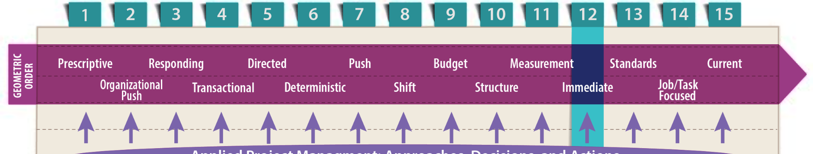
Lessons Learned
1
Enhanced Communication
2
Agile Adaptation
3
Proactive Issue Resolution
Agile methodologies allowed for flexibility in response to changes.
Importance of clear communication in a remote setting.
Addressing challenges promptly prevents escalation.

Slide 10

Future Strategies
1
Training Sessions
2
Cross-Functional Collaboration
Conduct regular training sessions on new tools and methodologies.
Encourage collaboration between different departments for a holistic approach.
3
Continuous Feedback
Implement regular feedback loops to address emerging issues promptly.

